Slide 1

TrackGuard AI
Autonomous Railway Safety System
FAR AWAY 2026 • Railways Theme • Team: TECHNTHINKS
FAR AWAY 2026 • RAILWAYS THEME

Slide 2
The Problem — Why Railway Safety Needs a Revolution
India's railway network spans 68,000+ km of track — yet manual inspection is slow, error-prone and costly.
⚠️ Track Defects
🚨 Passenger Safety
📋 Manual Inspection
💧 Amenity Gaps
Rail fractures missed
Thermal expansion ignored
Weld failures undetected
Avg. response: 72hrs+
No real-time hazard alerts
Emergency stops delayed
No crowd density data
Blind spots at stations
Only 2–3 km/hr speed
Weather limitations
Human fatigue errors
High operational cost
No water supply mapping
Untracked washroom status
Ticket counter queues
No digital reporting

Slide 3
Solution — TrackGuard AI: 3-Layer Safety Ecosystem
One integrated platform replacing manual inspection with AI, robotics, and citizen reporting.
LAYER 1
LAYER 2
LAYER 3
Citizen Safety App
Autonomous Track Robot
Smart Sensor Network
AI-powered hazard reporting
Full station amenity map
Real-time crowd alerts
Integrated ticket system
LiDAR 3D track scanning
Caterpillar autonomous nav
2D→3D point cloud fusion
Predictive maintenance AI
Pressure sensor trip-wire
Camera feedback loops
Emergency stop triggers
Live telemetry dashboard

Slide 4
Layer 1 — Citizen Safety App (Web + Mobile PWA)
🗺️ Station Map
Interactive map of every platform, ticket counter, washroom, water point & waiting area
TECH STACK
Frontend: React PWA + Leaflet.js
Backend: FastAPI (Python)
Database: PostgreSQL + PostGIS
AI: YOLOv8 hazard classifier
Maps: OpenStreetMap / OSRM
Auth: JWT + OTP (Railway ID)
Hosting: AWS EC2 + S3
Notifications: Firebase FCM
📸 AI Hazard Report
Photo/video upload → on-device AI classifies hazard type and routes to maintenance
💧 Amenity Status
Crowd-sourced live status of water, toilets, food stalls — updated every 15 min
🔔 Emergency Alert
Push alerts for track closures, delays, emergency evacuations
📊 Dashboard (Staff)
Maintenance team portal: heat-maps, open tickets, SLA tracking

Slide 5
Layer 2 — Your Actual Robot: Dual-Mode 3D Scanning Mobile Robot
Dual-mode LiDAR (linear 0° + conical 30°) · Jetson Nano GPU · Caterpillar tracked chassis · PROVEN: 1.84M point cloud @ 145s
🧠 Main CPU/GPU NVIDIA Jetson Nano
📡 LiDAR RPLiDAR A2 (Dual-Mode)
Quad-core ARM + 128-core Maxwell GPU
Runs SLAM, 3D reconstruction, AI fault detection
Linear 0° lock → flat track scan
30° tilt conical → full 3D point cloud (.pcd)
🔄 LiDAR Mount Dual-Angle Pivot Mechanism
📷 Camera Binocular Depth (Stereo SLAM)
High-precision 360° NEMA-17 servo base (Z-axis)
Mechanical solenoid/detent locks 0° or 30°
Stereo IR array for depth + proximity
Loop closure and visual odometry
📐 IMU BNO055 9-Axis
⚙️ Drive Four-Motor + Caterpillar Tracks
Accel + Gyro + Barometer via I²C
Fuses with LiDAR for robust odometry
Independent actuators per track
Aluminum extrusion frame, ballast-ready

Slide 6
Dual-Mode LiDAR Pipeline — 2D Linear + 3D Conical Fusion
MODE 1 — LINEAR (0° Lock)
MODE 2 — CONICAL (30° Lock)
LiDAR tilted to 0° — scans flat plane
Maps exact track geometry cross-section
Detects rail gap, crack, misalignment
Fast traverse mode (robot moving)
Output: 2D distance/angle array via CAN Bus
LiDAR tilts 30° + 360° NEMA-17 rotation
Each rotation = 1 horizontal slice of 3D cone
Slices stacked → full 3D point cloud .pcd
Stopped-robot deep-scan mode
Output: 1.84M points proven in 145 seconds
JETSON NANO SENSOR FUSION PIPELINE (CAN Bus Architecture)
LiDAR
(dist/angle)
360° Servo
Encoder
Binocular
Camera
JETSON
NANO
9-Axis IMU
BNO055
Motor Driver
& Actuators
.pcd
Output
CAN
CAN
I²C
I²C
I²C

Slide 7
Layer 3 — Smart Sensor Network & Emergency Systems
Pressure / Vibration Sensors
PCB DESIGN
Piezoelectric sensors embedded every 500m along tracks. Detects unusual vibrations — derailment, object on track — and triggers emergency braking signal within 200ms.
MCU: STM32F103C8T6 (Blue Pill)
Sensor ADC: ADS1115 16-bit
LoRa: SX1278 module
Power: AMS1117 3.3V regulator
MOSFET relay: IRF540N
PCB: 2-layer 5V/3.3V rails
KiCad schematic + Gerbers
EasyEDA for verification
Camera Feedback Loops
PTZ cameras at junctions & stations stream to edge-AI box running YOLOv8. Detects trespassers, obstacle intrusion, crowd overflow.
Emergency Rail Stopper
Electromagnetic rail-clamp actuated by sensor network or manual override. Certified fail-safe: power-off defaults to engaged.

Slide 8
Full System Architecture — Hardware-Accurate Block Diagram
Based on your actual robot design: Jetson Nano main hub, CAN Bus for LiDAR/servo, I²C for sensors, LoRa for telemetry
🤖 AUTONOMOUS ROBOT (Jetson Nano)
☁️ CLOUD + CITIZEN LAYER
RPLiDAR A2
Dual-Mode
NEMA-17 Servo
360° Z-Axis
FastAPI Server + PostgreSQL + PostGIS
Binocular Cam
Stereo SLAM
BNO055 IMU
9-Axis Fusion
React PWA Citizen App (Hazard Report + Map)
LoRa
+WiFi
4-Motor Drive
Caterpillar
.pcd Output
1.84M pts/scan
YOLOv8 Track Fault Classifier (range image)
Maintenance Dashboard + Alert Engine
NVIDIA JETSON NANO — Main CPU/GPU — CAN Bus + I²C Hub
STM32 Sensor Nodes — LoRa → Gateway → API

Slide 9
GitHub Repository Structure & Submission Guide
Repo: github.com/[yourname]/trackguard-ai
📁 Repo Folders
📋 Required Files
✅ FAR AWAY Rules
/app — React PWA frontend
/backend — FastAPI server
/robot — RPi firmware (Python)
/arduino — STM32 sensor code
/pcb — KiCad schematic + Gerbers
/cad — Robot chassis STL files
/docs — Report, diagrams, BOM
/demo — Screenshots, video link
README.md (full setup guide)
requirements.txt / package.json
LICENSE (MIT)
ARCHITECTURE.md
BOM.csv (Bill of Materials)
.gitignore
demo/VIDEO_LINK.txt
docs/circuit_diagram.png
✔ GitHub repo with source code
✔ 15-slide presentation (this deck)
✔ Problem→Solution→Demo flow
✔ PCB design files (KiCad)
✔ CAD files for robot chassis
✔ Real prototype (encouraged)
✔ Setup instructions in README
✔ Commit history visible

Slide 10
PCB Design & Bill of Materials (BOM)
Two custom PCBs: (1) Sensor Node Board (2) Robot Controller Hat
Component | Qty | Purpose | Approx Cost (₹)
Raspberry Pi 4B (4GB) | 1 | Main AI compute | ₹6,500
Arduino Mega 2560 | 1 | Motor + sensor ctrl | ₹900
RPLiDAR A2M8 | 1 | 2D LiDAR scanner | ₹8,000
STM32F103C8T6 | 2 | Sensor node MCU | ₹120×2
OV5647 Camera | 2 | Visual inspection | ₹700×2
SX1278 LoRa Module | 3 | Long-range comms | ₹350×3
4S LiPo 5000mAh | 1 | Robot power | ₹2,200
L298N Motor Driver | 2 | Caterpillar drive | ₹150×2
Piezo Vibration Sensor | 10 | Track sensing | ₹40×10
ADS1115 ADC | 2 | 16-bit sensor read | ₹180×2
IRF540N MOSFET | 4 | Relay/actuator ctrl | ₹25×4
Misc (PCB, wire, nuts) | — | Hardware | ₹1,500
TOTAL ESTIMATED PROTOTYPE COST: ₹ ~23,000 • Tool: KiCad 6 + EasyEDA • Fab: JLCPCB (5 boards ~₹800)

Slide 11
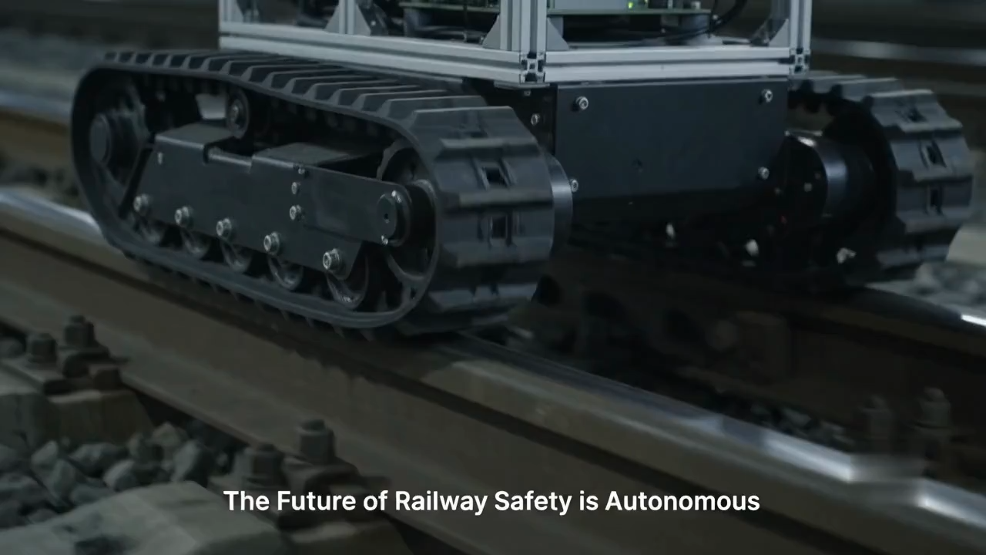

Slide 12
Development Roadmap & Milestones
Phase 1
0–2 Months
Phase 2
2–4 Months
Phase 3
4–6 Months
Phase 4
6–12 Months
Citizen App MVP
Hazard reporting live
Station map for 3 stations
Backend API deployed
Robot chassis built
LiDAR + camera integrated
First 500m track test
Fault detection model v1
Sensor network nodes
Emergency stopper prototype
PCBs fabricated + tested
Full system integration
Pilot: 1 railway zone
Government partnership
Scale to 5 divisions
Open-source SDK release

Slide 13
Impact, Scale & Market Opportunity
68,000+
1.4B+
₹1,200 Cr
83%
$4.5B
km of Indian Railways
Passengers per year
Annual maintenance cost
Accidents from track faults
Global rail safety market
COMPETITIVE EDGE
🔁 Fully autonomous — no human needed
📡 LoRa works without 4G coverage
🤖 3-layer redundancy (app + robot + sensor)
💰 10× cheaper than imported rail robots
🇮🇳 Made-for-India: fits Indian gauge track
🔓 Open-source hardware + software

Slide 14
Demo — What Judges Will See
🌐 App Demo (Live URL)
PWA deployed on Vercel. Judges can scan QR to open, report a hazard, see it appear on dashboard in real-time.
🤖 Robot Simulation
Python simulation (Pygame / ROS Gazebo) showing autonomous track traversal, LiDAR sweep, and fault detection trigger.
📊 Dashboard
Staff portal showing open tickets, heat-map of reported hazards, sensor alert log, and analytics.
🔌 Sensor Node
Physical STM32 board with piezo sensor — press it to trigger a virtual emergency stop on the dashboard.
📹 Field Video
60-second clip of robot prototype on mock track (PVC pipe rail), LiDAR spinning, fault detection alert firing.

Slide 15
How We Score on FAR AWAY Judging Criteria
★★★★★
3-layer system + LiDAR 3D + on-device AI + LoRa mesh — none of this is off-the-shelf
★★★★★
Custom PCB (KiCad), robot chassis (CAD), real firmware, no breadboard-only prototype
★★★★★
Solves measurable problem: 83% of rail accidents are track-related — addressable by this
★★★★☆
LoRa + cloud scales without per-node SIM cost; open-source enables govt. adoption
★★★★★
PWA citizen app designed for low-tech users; WCAG-compliant; Hindi/English support
★★★★★
GitHub repo, working demo, PCB files, CAD, video, presentation — fully complete

Slide 16
TrackGuard AI
Making India's Railways Safer — One Kilometer at a Time
🔗 GitHub :https://github.com/rudrakshapatra/TrackGuard-Railway-safety.git
📧 Team : TECHNTHINK
🎥 Demo Video : youtu.be/technthink
FAR AWAY 2026 • Railways Theme • India's Biggest International Hackathon

